Slide 1
PHYS 304: Lecture 22 (Intro to) Quantum Mechanics
Sept-Dec 2021 Edition
Jeff Young
brimacombe Rm 278, young@phas.ubc.ca

Slide 2
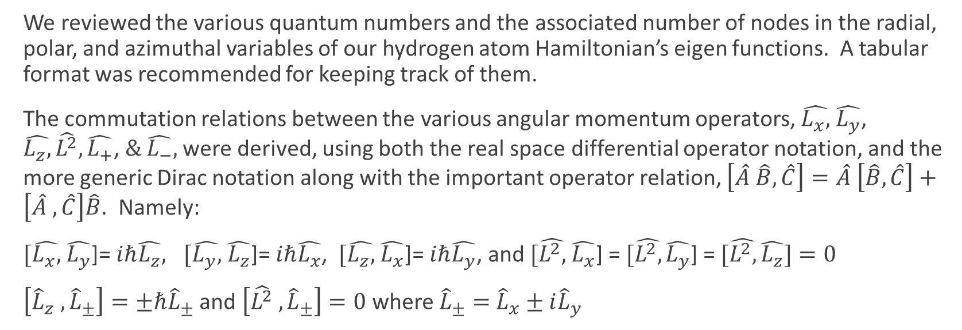
Review of key points from last lecture
We reviewed the various quantum numbers and the associated number of nodes in the radial, polar, and azimuthal variables of our hydrogen atom Hamiltonian’s eigen functions. A tabular format was recommended for keeping track of them.
The commutation relations between the various angular momentum operators, $\hat{L_{x},}$ $\hat{L_{y}}$, $\hat{L_{z},}\hat{L^{2}},\hat{L_{+}}\text{,} \& \hat{L_{−}},$ were derived, using both the real space differential operator notation, and the more generic Dirac notation along with the important operator relation, $\left[\hat{A} \hat{B}, \hat{C}\right]=\hat{A} \left[\hat{B},\hat{C}\right]+\left[\hat{A} ,\hat{C}\right]\hat{B}$. Namely:
$[\hat{L_{x},}$ $\hat{L_{y}}$]= $iℏ\hat{L_{z}}, [\hat{L_{y},}$ $\hat{L_{z}}$]= $iℏ\hat{L_{x}}$, $[\hat{L_{z},}$ $\hat{L_{x}}$]= $iℏ\hat{L_{y}}$, and $[\hat{L^{2},}$ $\hat{L_{x}}$] = $[\hat{L^{2},}\hat{L_{y}}$] = $[\hat{L^{2},}\hat{L_{z}}]=0$
$\left[{\hat{L}}_{z} ,{\hat{L}}_{±}\right]=±ℏ{\hat{L}}_{±}$ and $\left[\hat{L^{2}} ,{\hat{L}}_{±}\right]=0$ where ${\hat{L}}_{±}=$ ${\hat{L}}_{x}±i{\hat{L}}_{y}$

Slide 3
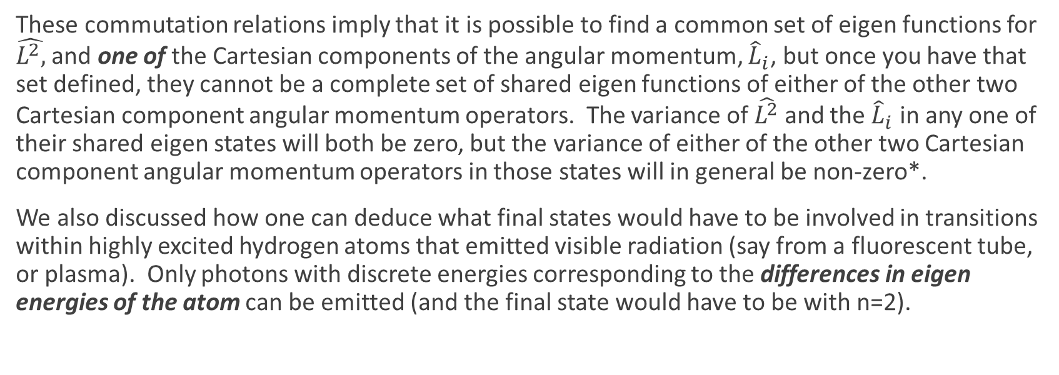
Review of key points from last lecture
These commutation relations imply that it is possible to find a common set of eigen functions for $\hat{L^{2},}$ and one of the Cartesian components of the angular momentum, ${\hat{L}}_{i}$, but once you have that set defined, they cannot be a complete set of shared eigen functions of either of the other two Cartesian component angular momentum operators. The variance of $\hat{L^{2}}$ and the ${\hat{L}}_{i}$ in any one of their shared eigen states will both be zero, but the variance of either of the other two Cartesian component angular momentum operators in those states will in general be non-zero*.
We also discussed how one can deduce what final states would have to be involved in transitions within highly excited hydrogen atoms that emitted visible radiation (say from a fluorescent tube, or plasma). Only photons with discrete energies corresponding to the differences in eigen energies of the atom can be emitted (and the final state would have to be with n=2).
* Note that the $l=m=0$ case is a pathological exception, where the variances of all cartesian angular momenta, and the total angular momentum are all zero. (what is the shared eigen function in that case?)

Slide 4
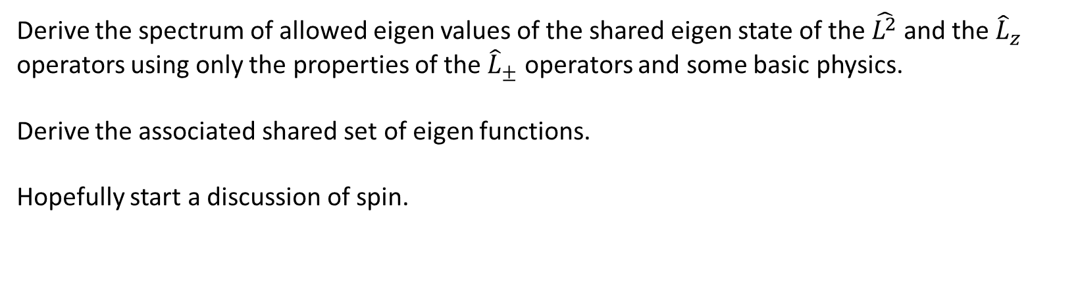
Today
Derive the spectrum of allowed eigen values of the shared eigen state of the $\hat{L^{2}}$ and the ${\hat{L}}_{z}$ operators using only the properties of the ${\hat{L}}_{±}$ operators and some basic physics.
Derive the associated shared set of eigen functions.
Hopefully start a discussion of spin.

Slide 5
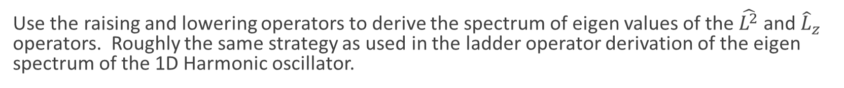

General spectrum of common eigenstates of the $\hat{L^{2}}$ and ${\hat{L}}_{z}$ operators
Use the raising and lowering operators to derive the spectrum of eigen values of the $\hat{L^{2}}$ and ${\hat{L}}_{z}$ operators. Roughly the same strategy as used in the ladder operator derivation of the eigen spectrum of the 1D Harmonic oscillator.
Step 1: Define terms
Step 2: Show that the states ${\hat{L}}_{±}|ψ_{λ}⟩$ are also eigen states of $\hat{L^{2}}$ with the same eigen value $λ.$
Step 3: Knowing that there must be a shared set of eigen functions with ${\hat{L}}_{z}$, what are the corresponding eigen values?
Step 4: Introduce some basic physics (any component can’t be larger than the total angular momentum)
Step 5: Implications (there must be a maximum eigen value of the ${\hat{L}}_{z}$ operator
Step 6: Apply same strategy to find the lowest possible (negative) eigen value of the ${\hat{L}}_{z}$ operator consistent with ${\left|μ\right|}^{2}≤λ$.
Step 7: The full spectrum.

Slide 6
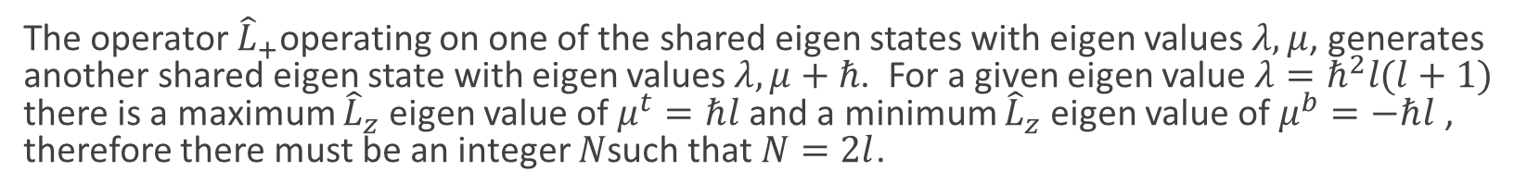
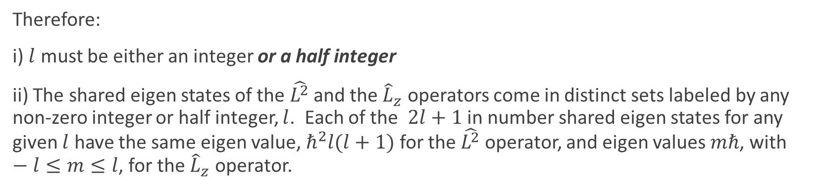
General spectrum of common eigenstates of the $\hat{L^{2}}$ and ${\hat{L}}_{z}$ operators
The operator ${\hat{L}}_{+}$operating on one of the shared eigen states with eigen values $λ,μ$, generates another shared eigen state with eigen values $λ,μ+ℏ$. For a given eigen value $λ=ℏ^{2}l(l+1)$ there is a maximum ${\hat{L}}_{z}$eigen value of $μ^{t}=ℏl$and a minimum ${\hat{L}}_{z}$eigen value of $μ^{b}=−ℏl$, therefore there must be an integer $N$such that $N=2l$.
Therefore:
i) $l$ must be either an integer or a half integer
ii) The shared eigen states of the $\hat{L^{2}}$ and the ${\hat{L}}_{z}$ operators come in distinct sets labeled by any non-zero integer or half integer, $l$. Each of the $2l+1$ in number shared eigen states for any given $l$ have the same eigen value, $ℏ^{2}l(l+1)$ for the $\hat{L^{2}}$ operator, and eigen values $mℏ$, with $−l≤m≤l$, for the ${\hat{L}}_{z}$ operator.

Slide 7

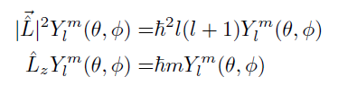
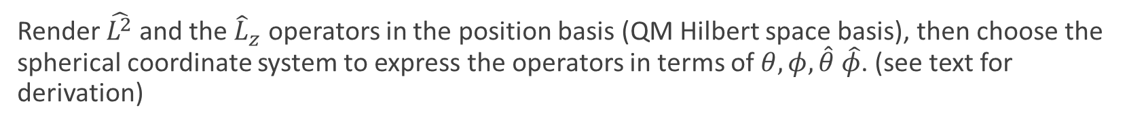
The eigen functions
The eigen functions. Can’t avoid solving the eigen value problem(s)!
Render $\hat{L^{2}}$ and the ${\hat{L}}_{z}$ operators in the position basis (QM Hilbert space basis), then choose the spherical coordinate system to express the operators in terms of $θ,φ, \hat{θ} \hat{φ}$. (see text for derivation)

Slide 8
POLLS:
POLL #1: If you measured the magnitude of the angular momentum, and then followed that with a measurement of the z component of the angular momentum, another measurement of the magnitude of the angular momentum of the resulting state would yield:
a) the same value as originally measured
b) some value that cannot be precisely predicted
POLL #2: If you measured the magnitude of the angular momentum, and then followed that with a measurement of the z component of the angular momentum, a third measurement of the x component of the angular momentum would yield:
a) the same value as measured for the x component in the second measurement
b) some value that cannot be precisely predicted
c) some value that cannot be precisely predicted, except in the case where the first two measurements yielded zero.

Slide 9





























Example

Slide 10











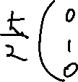



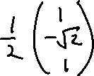
Example

Slide 11











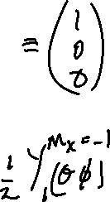


Example

Slide 12

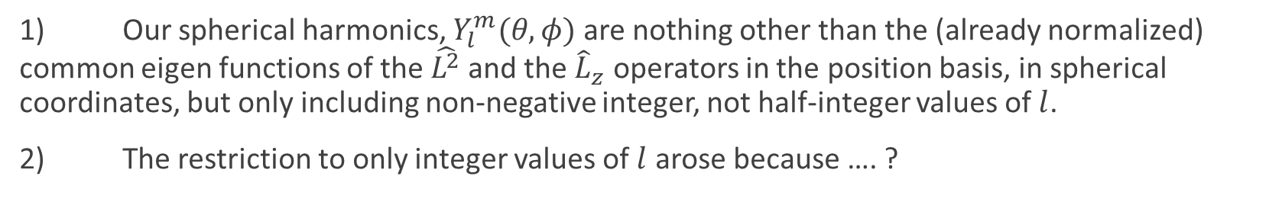
Implications more generally
1) Our spherical harmonics, $Y_{l}^{m}(θ,φ)$ are nothing other than the (already normalized) common eigen functions of the $\hat{L^{2}}$ and the ${\hat{L}}_{z}$ operators in the position basis, in spherical coordinates, but only including non-negative integer, not half-integer values of $l$.
2) The restriction to only integer values of $l$ arose because …. ?
Because we forced the associated wavefunctions, in the position basis, to be single-valued at all positions (in particular all values of $φ$, modulo $2π$).
Did we screw up, are their also solutions of our hydrogen atom Hamiltonian that have half integer values of $l$ and $m$?
No, the result is experimentally correct, validating the assumption of the single-valued nature of position space wavefunction. Then did we screw up in the derivation of the general spectrum?

Slide 13



Apparently not! Electron spin
If there was an measurement apparatus that could deflect a stream of incident atoms upwards or downwards an amount proportional to the z component of their angular momentum, sketch what would you expect to see on a screen that imaged the particles coming out the other side in the cases: i) a hydrogen atom in state i) ψ_{1,0,0} , ii) ψ_{2,1,0} , iii) ψ_{2,1,1} , and iv) ψ_{2,1,-1 .}
Screen
z
Notes:
Should be fairly quick: upwards in proportion to hbar

Slide 14
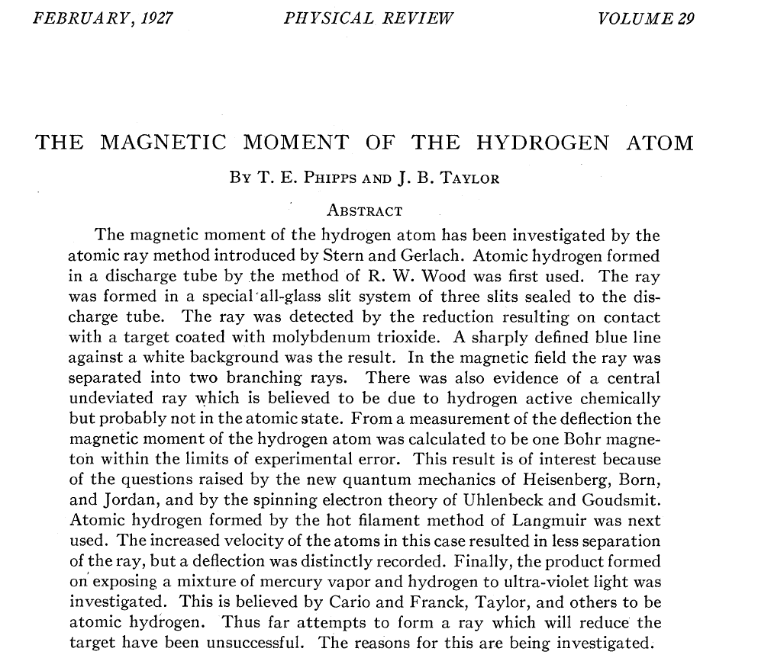

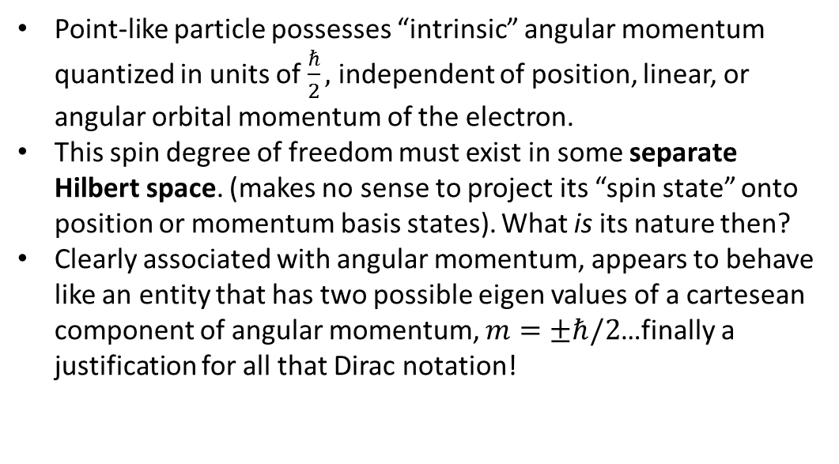
Electron spin
It turns out that if you send a beam of hydrogen atoms in the $ψ_{1,0,0}$ state through such an apparatus, there are two spots on the screen corresponding to an upward and downward deflection one would expect for a particle having an angular momentum $±ℏ/2$. What are the implications of this observation?
Point-like particle possesses “intrinsic” angular momentum quantized in units of $\frac{ℏ}{2},$ independent of position, linear, or angular orbital momentum of the electron.
This spin degree of freedom must exist in some separate Hilbert space. (makes no sense to project its “spin state” onto position or momentum basis states). What is its nature then?
Clearly associated with angular momentum, appears to behave like an entity that has two possible eigen values of a cartesean component of angular momentum, $m=±ℏ/2$…finally a justification for all that Dirac notation!
Notes:
The electron must possess an “intrinsic” angular momentum, regardless of it’s “motion in space”…hence the term spin.
As far as we know, the electron is a fundamental quantum mechanical property with no measurable (or measured) intrinsic size. As we have learned, quantum mechanics associates a probability distribution for where this infinitely small particle might be observed when it is in some given QM state, but the particle itself has no known size…it is “fundamental” until we can find its constituents. Just as this fundamental particle has an associated charge, it seems it also has an intrinsic angular momentum.
Can picture it as some spinning sphere of charge where in some limit of its radius going to zero and its spin rate going to infinity, there is a quantized angular momentum…but of course we can’t justify this picture!
This intrinsic “spin” angular momentum is fixed for a given fundamental particle…its Hilbert space can’t be altered by interactions with fields or other particles, although transitions between states within its Hilbert space can be induced.
Its Hilbert space is completely distinct/orthogonal to the Hilbert space associated with square integrable functions in space, which means it makes no sense to ask what the expansion of a fundamental spin state is in the real space, or momentum space basis: the only relevant bases are in “spinor space”.
This actually makes QM operations easier, in many respects, in spin space than function space (could have largely avoided chapter 3!!), although it is manifestly abstract from the outset.

Slide 15
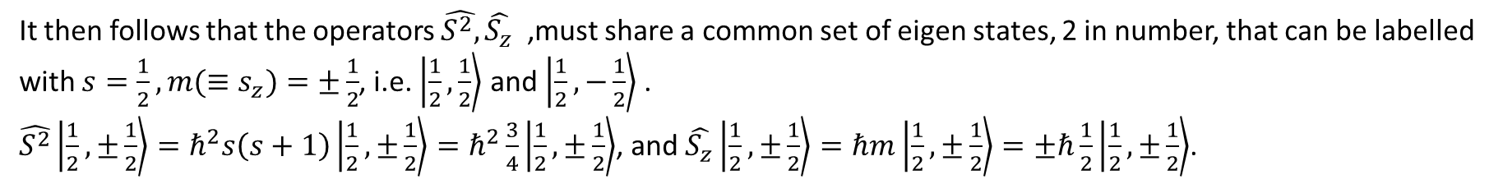
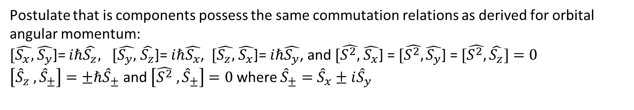
Electron spin
Postulate a “spin operator” $\hat{\vec{S}}$ that only operates on the intrinsic spin of the electron.
Postulate that is components possess the same commutation relations as derived for orbital angular momentum:
$[\hat{S_{x},}$ $\hat{S_{y}}$]= $iℏ\hat{S_{z}}, [\hat{S_{y},}$ $\hat{S_{z}}$]= $iℏ\hat{S_{x}}$, $[\hat{S_{z},}$ $\hat{S_{x}}$]= $iℏ\hat{S_{y}}$, and $[\hat{S^{2},}$ $\hat{S_{x}}$] = $[\hat{S^{2},}\hat{S_{y}}$] = $[\hat{S^{2},}\hat{S_{z}}]=0$
$\left[{\hat{S}}_{z} ,{\hat{S}}_{±}\right]=±ℏ{\hat{S}}_{±}$ and $\left[\hat{S^{2}} ,{\hat{S}}_{±}\right]=0$ where ${\hat{S}}_{±}=$ ${\hat{S}}_{x}±i{\hat{S}}_{y}$
It then follows that the operators $\hat{S^{2},}\hat{S_{z}}$ ,must share a common set of eigen states, 2 in number, that can be labelled with $s=\frac{1}{2},m(≡s_{z})=±\frac{1}{2}$, i.e. $\left|\frac{1}{2},\frac{1}{2}\right\rangle$ and $\left|\frac{1}{2},−\frac{1}{2}\right\rangle$ .
$\hat{S^{2}}\left|\frac{1}{2},±\frac{1}{2}\right\rangle =ℏ^{2}s\left(s+1\right)\left|\frac{1}{2},±\frac{1}{2}\right\rangle =ℏ^{2}\frac{3}{4}\left|\frac{1}{2},±\frac{1}{2}\right\rangle$, and $\hat{S_{z}}\left|\frac{1}{2},±\frac{1}{2}\right\rangle =ℏm\left|\frac{1}{2},±\frac{1}{2}\right\rangle =±ℏ\frac{1}{2}\left|\frac{1}{2},±\frac{1}{2}\right\rangle$.
Also,${\hat{S}}_{±}\left|\frac{1}{2},±\frac{1}{2}\right\rangle =ℏ\sqrt{s(s+1)−m(m±1)}\left|\frac{1}{2},±\frac{1}{2}±1\right\rangle$ and ${\hat{S}}_{±}$, $\hat{S_{z}}$ , and $\hat{S^{2},}$ commute with any $f(\hat{\vec{r}},\hat{\vec{p}})$.
Notes:
The logic is:
We understood from the analysis of orbital angular momentum operators, very general properties of the vector components of angular momentum operators.
Experimentally it appears that electrons possess an intrinsic angular momentum independent of the position or velocity.
Assume that there are “spin angular momentum” operators that operate on an abstract 2D complex Hilbert space [why 2D?] that is totally orthogonal to (independent of) real space, and that these spin operators possess the same properties as the general orbital angular momentum operators we analyzed last lecture.
Generalize this to allow for intrinsic spin Hilbert spaces corresponding to intrinsic spins other than just the two dimensional spin ½ space.

Slide 16

Electron spin
An arbitrary state in the spin ½ Hilbert space can then be written most generally as $\left|χ\left(t\right)\right\rangle =a\left(t\right)\left|\frac{1}{2},\frac{1}{2}\right\rangle +b\left(t\right)\left|\frac{1}{2},−\frac{1}{2}\right\rangle$
What is the unity operator in this Hilbert space, and how does it relate to $a\left(t\right),b\left(t\right)?$
$$\hat{I}=\left|\frac{1}{2},\frac{1}{2}\right\rangle \left\langle \frac{1}{2},\frac{1}{2}\right|+\left|\frac{1}{2},−\frac{1}{2}\right\rangle \left\langle \frac{1}{2},−\frac{1}{2}\right|, \left|χ\left(t\right)\right\rangle =\hat{I}\left|χ\left(t\right)\right\rangle ∴a\left(t\right)=⟨\frac{1}{2},\frac{1}{2}|χ\left(t\right)⟩; b\left(t\right)=⟨\frac{1}{2},−\frac{1}{2}\left|χ(t)\right\rangle$$
Most easily dealt with using matrix/vector representation: $\left|\frac{1}{2},\frac{1}{2}\right\rangle ≡\left(\begin{matrix}1 \\ 0\end{matrix}\right), \left|\frac{1}{2},−\frac{1}{2}\right\rangle ≡\left(\begin{matrix}0 \\ 1\end{matrix}\right), \left|χ\left(t\right)\right\rangle ≡\left(\begin{matrix}a(t) \\ b(t)\end{matrix}\right)$
From chapter 3, what would you call $\left(\begin{matrix}a(t) \\ b(t)\end{matrix}\right)$ ?
Notes:
The wavefunction of the spin ½ state \chi in the S_z basis

Slide 17
Electron spin
What are the matrix representations of the various spin operators in this basis?
$\hat{S_{i,j}^{2}}≡⟨\frac{1}{2},i|\hat{S^{2}}|\frac{1}{2},j⟩$, ${\hat{S_{z}}}_{i,j}≡\left\langle \frac{1}{2},i|{\hat{S}}_{z}|\frac{1}{2},j\right\rangle$, spend a few minutes trying to find these matrix reps
$\hat{S^{2}}≡\frac{3}{4}ℏ^{2}\left[\begin{matrix}1 & 0 \\ 0 & 1\end{matrix}\right]$ $\hat{S_{z}}≡\frac{1}{2}ℏ\left[\begin{matrix}1 & 0 \\ 0 & −1\end{matrix}\right]$ $\hat{S_{+}}≡ℏ\left[\begin{matrix}0 & 1 \\ 0 & 0\end{matrix}\right]$ $\hat{S_{−}}≡ℏ\left[\begin{matrix}0 & 0 \\ 1 & 0\end{matrix}\right]$
$\hat{S_{x}}≡\frac{1}{2}ℏ\left[\begin{matrix}0 & 1 \\ 1 & 0\end{matrix}\right]$ $\hat{S_{y}}≡\frac{1}{2}ℏ\left[\begin{matrix}0 & −i \\ i & 0\end{matrix}\right]$

Slide 18

Electron spin
The Pauli Spin matrices:
$\hat{S_{i}}≡\frac{ℏ}{2} \hat{σ_{i}}$ for $i=x,y,z$
$\hat{σ_{x}}≡\left[\begin{matrix}0 & 1 \\ 1 & 0\end{matrix}\right]$ $\hat{σ_{y}}≡\left[\begin{matrix}0 & −i \\ i & 0\end{matrix}\right]$ $\hat{σ_{z}}≡\left[\begin{matrix}1 & 0 \\ 0 & −1\end{matrix}\right]$

